Slide 1
Unit 3

Slide 2
Outline
Model checking
Inference in first-order logic
Inference rules
Forward chaining
Backward chaining
Resolution
Clausal form
Unification
Resolution as search

Slide 3
Model checking
Given KB, does sentence S hold?
Basically generate and test:
Generate all the possible models
Consider the models M in which KB is TRUE
If ∀M S , then S is provably true
If ∀M ¬S, then S is provably false
Otherwise (∃M1 S ∧ ∃M2 ¬S): S is satisfiable but neither provably true or provably false

Slide 4
Efficient model checking
Davis-Putnam algorithm (DPLL): Generate-and-test model checking with:
Early termination (short-circuiting of disjunction and conjunction)
Pure symbol heuristic: Any symbol that only appears negated or unnegated must be FALSE/TRUE respectively. (Can “conditionalize” based on instantiations already produced)
Unit clause heuristic: Any symbol that appears in a clause by itself can immediately be set to TRUE or FALSE
WALKSAT: Local search for satisfiability: Pick a symbol to flip (toggle TRUE/FALSE), either using min-conflicts or choosing randomly
…or you can use any local or global search algorithm!

Slide 5
Universal instantiation (UI)
Every instantiation of a universally quantified sentence is entailed by it:
∀v α Subst({v/g}, α)
for any variable v and ground term g
E.g., ∀x King(x) ∧ Greedy(x) ⇒ Evil(x) yields:
King(John) ∧ Greedy(John) ⇒ Evil(John)
King(Richard) ∧ Greedy(Richard) ⇒ Evil(Richard)
King(Father(John)) ∧ Greedy(Father(John)) ⇒ Evil(Father(John))
.
.
.

Slide 6
Existential instantiation (EI)
For any sentence α, variable v, and constant symbol k that does not appear elsewhere in the knowledge base:
∃v α
Subst({v/k}, α)
E.g., ∃x Crown(x) ∧ OnHead(x,John) yields:
Crown(C₁) ∧ OnHead(C₁,John)
provided C₁ is a new constant symbol, called a Skolem constant

Slide 7
Reduction to propositional inference
Suppose the KB contains just the following:
∀x King(x) ∧ Greedy(x) ⇒ Evil(x)
King(John)
Greedy(John)
Brother(Richard,John)
Instantiating the universal sentence in all possible ways, we have:
King(John) ∧ Greedy(John) ⇒ Evil(John)
King(Richard) ∧ Greedy(Richard) ⇒ Evil(Richard)
King(John)
Greedy(John)
Brother(Richard,John)
The new KB is propositionalized: proposition symbols are
King(John), Greedy(John), Evil(John), King(Richard), etc.

Slide 8
Reduction contd.
Every FOL KB can be propositionalized so as to preserve entailment
(A ground sentence is entailed by new KB iff entailed by original KB)
Idea: propositionalize KB and query, apply resolution, return result
Problem: with function symbols, there are infinitely many ground terms,
e.g., Father(Father(Father(John)))

Slide 9
Reduction contd.
Theorem: Herbrand (1930). If a sentence α is entailed by an FOL KB, it is entailed by a finite subset of the propositionalized KB
Idea: For n = 0 to ∞ do
create a propositional KB by instantiating with depth-$n$ terms
see if α is entailed by this KB
Problem: works if α is entailed, loops if α is not entailed
Theorem: Turing (1936), Church (1936) Entailment for FOL is semidecidable (algorithms exist that say yes to every entailed sentence, but no algorithm exists that also says no to every nonentailed sentence.)

Slide 10
Problems with propositionalization
Propositionalization seems to generate lots of irrelevant sentences.
E.g., from:
∀x King(x) ∧ Greedy(x) ⇒ Evil(x)
King(John)
∀y Greedy(y)
Brother(Richard,John)
it seems obvious that Evil(John), but propositionalization produces lots of facts such as Greedy(Richard) that are irrelevant
With p k-ary predicates and n constants, there are p·n^{k} instantiations.

Slide 11
Reminder: Inference rules for FOL
Inference rules for propositional logic apply to FOL as well
Modus Ponens, And-Introduction, And-Elimination, …
New (sound) inference rules for use with quantifiers:
Universal elimination
Existential introduction
Existential elimination
Generalized Modus Ponens (GMP)

Slide 15
Unification

Slide 16
Unification
Unification is a “pattern-matching” procedure
Takes two atomic sentences, called literals, as input
Returns “Failure” if they do not match and a substitution list, θ, if they do
That is, unify(p,q) = θ means subst(θ, p) = subst(θ, q) for two atomic sentences, p and q
θ is called the most general unifier (mgu)
All variables in the given two literals are implicitly universally quantified
To make literals match, replace (universally quantified) variables by terms

Slide 19
Unification algorithm
procedure unify(p, q, θ)
Scan p and q left-to-right and find the first corresponding
terms where p and q “disagree” (i.e., p and q not equal)
If there is no disagreement, return θ (success!)
Let r and s be the terms in p and q, respectively,
where disagreement first occurs
If variable(r) then {
Let θ = union(θ, {r/s})
Return unify(subst(θ, p), subst(θ, q), θ)
} else if variable(s) then {
Let θ = union(θ, {s/r})
Return unify(subst(θ, p), subst(θ, q), θ)
} else return “Failure”
end

Slide 20
Unification: Remarks
Unify is a linear-time algorithm that returns the most general unifier (mgu), i.e., the shortest-length substitution list that makes the two literals match.
In general, there is not a unique minimum-length substitution list, but unify returns one of minimum length
A variable can never be replaced by a term containing that variable
Example: x/f(x) is illegal.
This “occurs check” should be done in the above pseudo-code before making the recursive calls

Slide 21
Unification examples
Example:
parents(x, father(x), mother(Bill))
parents(Bill, father(Bill), y)
{x/Bill, y/mother(Bill)}
Example:
parents(x, father(x), mother(Bill))
parents(Bill, father(y), z)
{x/Bill, y/Bill, z/mother(Bill)}
Example:
parents(x, father(x), mother(Jane))
parents(Bill, father(y), mother(y))
Failure

Slide 22
Unification
We can get the inference immediately if we can find a substitution θ such that King(x) and Greedy(x) match King(John) and Greedy(y)
θ = {x/John,y/John} works
Unify(α,β) = θ if αθ = βθ
p q θ
Knows(John,x) Knows(John,Jane)
Knows(John,x) Knows(y,OJ)
Knows(John,x) Knows(y,Mother(y))
Knows(John,x) Knows(x,OJ)
Standardizing apart eliminates overlap of variables, e.g., Knows(z₁₇,OJ)

Slide 23
Unification
We can get the inference immediately if we can find a substitution θ such that King(x) and Greedy(x) match King(John) and Greedy(y)
θ = {x/John,y/John} works
Unify(α,β) = θ if αθ = βθ
p q θ
Knows(John,x) Knows(John,Jane) {x/Jane}}
Knows(John,x) Knows(y,OJ)
Knows(John,x) Knows(y,Mother(y))
Knows(John,x) Knows(x,OJ)
Standardizing apart eliminates overlap of variables, e.g., Knows(z₁₇,OJ)

Slide 24
Unification
We can get the inference immediately if we can find a substitution θ such that King(x) and Greedy(x) match King(John) and Greedy(y)
θ = {x/John,y/John} works
Unify(α,β) = θ if αθ = βθ
p q θ
Knows(John,x) Knows(John,Jane) {x/Jane}}
Knows(John,x) Knows(y,OJ) {x/OJ,y/John}}
Knows(John,x) Knows(y,Mother(y))
Knows(John,x) Knows(x,OJ)
Standardizing apart eliminates overlap of variables, e.g., Knows(z₁₇,OJ)

Slide 25
Unification
We can get the inference immediately if we can find a substitution θ such that King(x) and Greedy(x) match King(John) and Greedy(y)
θ = {x/John,y/John} works
Unify(α,β) = θ if αθ = βθ
p q θ
Knows(John,x) Knows(John,Jane) {x/Jane}}
Knows(John,x) Knows(y,OJ) {x/OJ,y/John}}
Knows(John,x) Knows(y,Mother(y)) {y/John,x/Mother(John)}}
Knows(John,x) Knows(x,OJ)
Standardizing apart eliminates overlap of variables, e.g., Knows(z₁₇,OJ)

Slide 26
Unification
We can get the inference immediately if we can find a substitution θ such that King(x) and Greedy(x) match King(John) and Greedy(y)
θ = {x/John,y/John} works
Unify(α,β) = θ if αθ = βθ
p q θ
Knows(John,x) Knows(John,Jane) {x/Jane}}
Knows(John,x) Knows(y,OJ) {x/OJ,y/John}}
Knows(John,x) Knows(y,Mother(y)) {y/John,x/Mother(John)}}
Knows(John,x) Knows(x,OJ) {fail}
Standardizing apart eliminates overlap of variables, e.g., Knows(z₁₇,OJ)

Slide 27
Unification
To unify Knows(John,x) and Knows(y,z),
θ = {y/John, x/z } or θ = {y/John, x/John, z/John}
The first unifier is more general than the second.
There is a single most general unifier (MGU) that is unique up to renaming of variables.
MGU = { y/John, x/z }

Slide 28
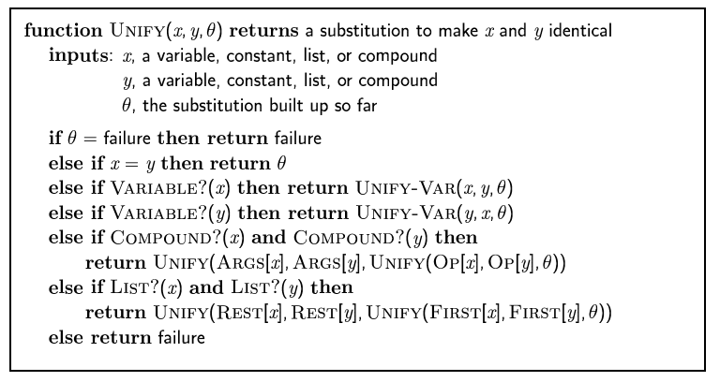
The unification algorithm

Slide 29
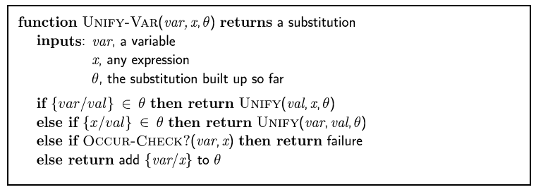
The unification algorithm

Slide 30
Automating FOL inference with Generalized Modus Ponens

Slide 31
Automated inference for FOL
Automated inference using FOL is harder than PL
Variables can potentially take on an infinite number of possible values from their domains
Hence there are potentially an infinite number of ways to apply the Universal Elimination rule of inference
Godel's Completeness Theorem says that FOL entailment is only semidecidable
If a sentence is true given a set of axioms, there is a procedure that will determine this
If the sentence is false, then there is no guarantee that a procedure will ever determine this—i.e., it may never halt

Slide 32
Generalized Modus Ponens (GMP)
Apply modus ponens reasoning to generalized rules
Combines And-Introduction, Universal-Elimination, and Modus Ponens
From P(c) and Q(c) and (∀x)(P(x) ∧ Q(x)) → R(x) derive R(c)
General case: Given
atomic sentences P₁, P₂, ..., P_{N}
implication sentence (Q₁ ∧ Q₂ ∧ ... ∧ Q_{N}) → R
Q₁, ..., Q_{N} and R are atomic sentences
substitution subst(θ, P_{i}) = subst(θ, Q_{i}) for i=1,...,N
Derive new sentence: subst(θ, R)
Substitutions
subst(θ, α) denotes the result of applying a set of substitutions defined by θ to the sentence α
A substitution list θ = {v₁/t₁, v₂/t₂, ..., v_{n}/t_{n}} means to replace all occurrences of variable symbol v_{i} by term t_{i}
Substitutions are made in left-to-right order in the list
subst({x/IceCream, y/Ziggy}, eats(y,x)) = eats(Ziggy, IceCream)

Slide 33
Horn clauses
A Horn clause is a sentence of the form:
(∀x) P₁(x) ∧ P₂(x) ∧ ... ∧ P_{n}(x) → Q(x)
where
there are 0 or more P_{i}s and 0 or 1 Q
the P_{i}s and Q are positive (i.e., non-negated) literals
Equivalently: P₁(x) ∨ P₂(x) … ∨ P_{n}(x) where the P_{i} are all atomic and at most one of them is positive
Prolog is based on Horn clauses
Horn clauses represent a subset of the set of sentences representable in FOL

Slide 34
Horn clauses II
Special cases
P₁ ∧ P₂ ∧ … P_{n} → Q
P₁ ∧ P₂ ∧ … P_{n} → false
true → Q
These are not Horn clauses:
p(a) ∨ q(a)
(P ∧ Q) → (R ∨ S)

Slide 35
Generalized Modus Ponens (GMP)
where p_{i}'θ = p_{i} θ for all i
p₁', p₂', … , p_{n}', ( p₁ ∧ p₂ ∧ … ∧ p_{n} ⇒q)
qθ
p₁' is King(John) p₁ is King(x)
p₂' is Greedy(y) p₂ is Greedy(x)
θ is {x/John,y/John} q is Evil(x)
q θ is Evil(John)
GMP used with KB of definite clauses (exactly one positive literal)
All variables assumed universally quantified

Slide 36
Soundness of GMP
Need to show that
p₁', …, p_{n}', (p₁ ∧ … ∧ p_{n} ⇒ q) ╞ qθ
provided that p_{i}'θ = p_{i}θ for all I
Lemma: For any sentence p, we have p ╞ pθ by UI
(p₁ ∧ … ∧ p_{n} ⇒ q) ╞ (p₁ ∧ … ∧ p_{n} ⇒ q)θ = (p₁θ ∧ … ∧ p_{n}θ ⇒ qθ)
p₁', \; …, \;p_{n}' ╞ p₁' ∧ … ∧ p_{n}' ╞ p₁'θ ∧ … ∧ p_{n}'θ
From 1 and 2, qθ follows by ordinary Modus Ponens

Slide 37
Example knowledge base
The law says that it is a crime for an American to sell weapons to hostile nations. The country Nono, an enemy of America, has some missiles, and all of its missiles were sold to it by Colonel West, who is American.
Prove that Col. West is a criminal

Slide 38
Example knowledge base contd.
... it is a crime for an American to sell weapons to hostile nations:
American(x) ∧ Weapon(y) ∧ Sells(x,y,z) ∧ Hostile(z) ⇒ Criminal(x)
Nono … has some missiles, i.e., ∃x Owns(Nono,x) ∧ Missile(x):
Owns(Nono,M₁) and Missile(M₁)
… all of its missiles were sold to it by Colonel West
Missile(x) ∧ Owns(Nono,x) ⇒ Sells(West,x,Nono)
Missiles are weapons:
Missile(x) ⇒ Weapon(x)
An enemy of America counts as "hostile“:
Enemy(x,America) ⇒ Hostile(x)
West, who is American …
American(West)
The country Nono, an enemy of America …
Enemy(Nono,America)

Slide 39
Forward chaining
Proofs start with the given axioms/premises in KB, deriving new sentences using GMP until the goal/query sentence is derived
This defines a forward-chaining inference procedure because it moves “forward” from the KB to the goal [eventually]
Inference using GMP is complete for KBs containing only Horn clauses

Slide 40
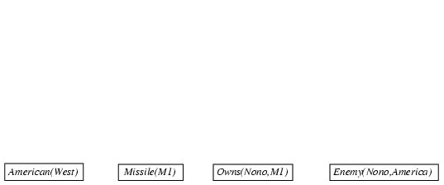
Forward chaining proof

Slide 41
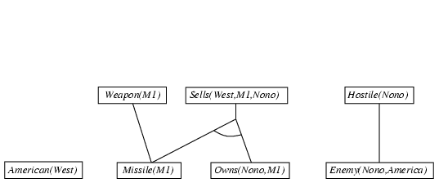
Forward chaining proof

Slide 42
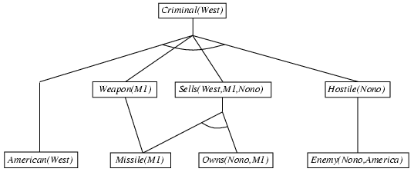
Forward chaining proof

Slide 43
Properties of forward chaining
Sound and complete for first-order definite clauses
Datalog = first-order definite clauses + no functions
FC terminates for Datalog in finite number of iterations
May not terminate in general if α is not entailed
This is unavoidable: entailment with definite clauses is semidecidable

Slide 47
Forward chaining example
KB:
allergies(X) → sneeze(X)
cat(Y) ∧ allergic-to-cats(X) → allergies(X)
cat(Felix)
allergic-to-cats(Lise)
Goal:
sneeze(Lise)

Slide 49
Efficiency of forward chaining
Incremental forward chaining: no need to match a rule on iteration k if a premise wasn't added on iteration k-1
⇒ match each rule whose premise contains a newly added positive literal
Matching itself can be expensive:
Database indexing allows O(1) retrieval of known facts
e.g., query Missile(x) retrieves Missile(M₁)
Forward chaining is widely used in deductive databases

Slide 50
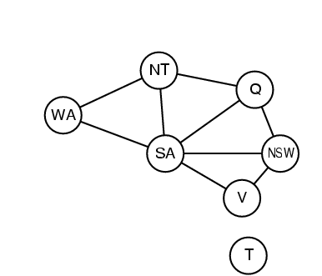
Hard matching example
Diff(wa,nt) ∧ Diff(wa,sa) ∧ Diff(nt,q) ∧ Diff(nt,sa) ∧ Diff(q,nsw) ∧ Diff(q,sa) ∧ Diff(nsw,v) ∧ Diff(nsw,sa) ∧ Diff(v,sa) ⇒ Colorable()
Diff(Red,Blue) Diff (Red,Green) Diff(Green,Red) Diff(Green,Blue) Diff(Blue,Red) Diff(Blue,Green)
Colorable() is inferred iff the CSP has a solution
CSPs include 3SAT as a special case, hence matching is NP-hard

Slide 51
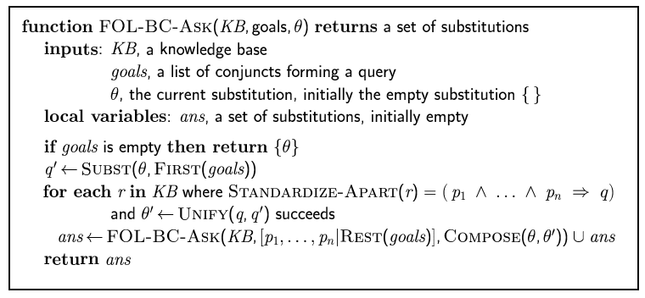
Backward chaining algorithm
SUBST(COMPOSE(θ₁, θ₂), p) = SUBST(θ₂, SUBST(θ₁, p))

Slide 52

Backward chaining example

Slide 53
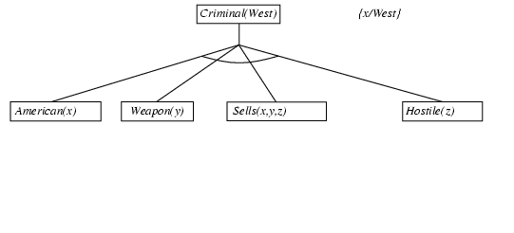
Backward chaining example

Slide 54
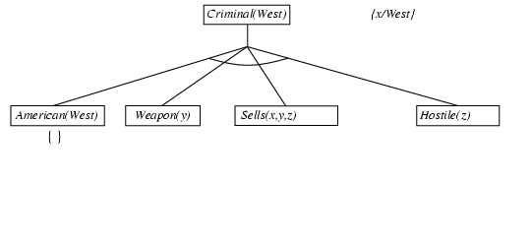
Backward chaining example

Slide 55
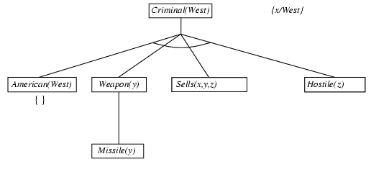
Backward chaining example

Slide 56
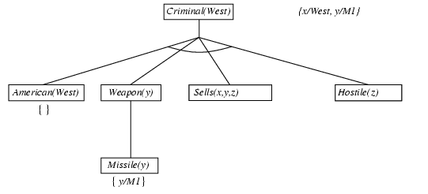
Backward chaining example

Slide 57
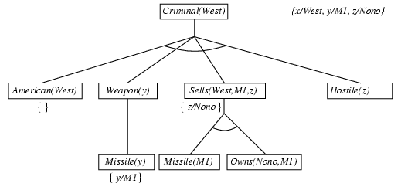
Backward chaining example

Slide 58
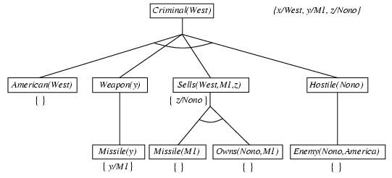
Backward chaining example

Slide 59
Backward chaining example

Slide 60
Properties of backward chaining
Depth-first recursive proof search: space is linear in size of proof
Incomplete due to infinite loops
⇒ fix by checking current goal against every goal on stack
Inefficient due to repeated subgoals (both success and failure)
⇒ fix using caching of previous results (extra space)
Widely used for logic programming

Slide 61
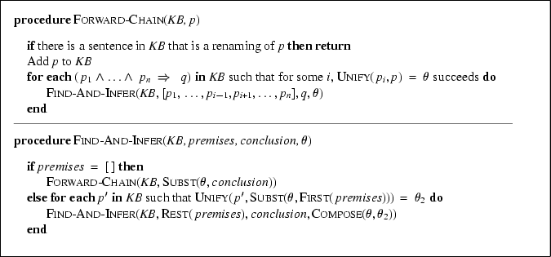
Forward chaining algorithm

Slide 62
Backward chaining
Backward-chaining deduction using GMP is also complete for KBs containing only Horn clauses
Proofs start with the goal query, find rules with that conclusion, and then prove each of the antecedents in the implication
Keep going until you reach premises
Avoid loops: check if new subgoal is already on the goal stack
Avoid repeated work: check if new subgoal
Has already been proved true
Has already failed

Slide 63
Backward chaining example
KB:
allergies(X) → sneeze(X)
cat(Y) ∧ allergic-to-cats(X) → allergies(X)
cat(Felix)
allergic-to-cats(Lise)
Goal:
sneeze(Lise)

Slide 64
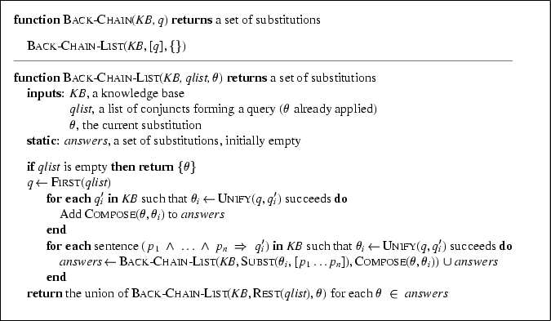
Backward chaining algorithm

Slide 65
Forward vs. backward chaining
FC is data-driven
Automatic, unconscious processing
E.g., object recognition, routine decisions
May do lots of work that is irrelevant to the goal
BC is goal-driven, appropriate for problem-solving
Where are my keys? How do I get to my next class?
Complexity of BC can be much less than linear in the size of the KB

Slide 66
Completeness of GMP
GMP (using forward or backward chaining) is complete for KBs that contain only Horn clauses
It is not complete for simple KBs that contain non-Horn clauses
The following entail that S(A) is true:
(∀x) P(x) → Q(x)
(∀x) ¬P(x) → R(x)
(∀x) Q(x) → S(x)
(∀x) R(x) → S(x)
If we want to conclude S(A), with GMP we cannot, since the second one is not a Horn clause
It is equivalent to P(x) ∨ R(x)

Slide 67
Automating FOL inference with resolution

Slide 68
Resolution
Resolution is a sound and complete inference procedure for FOL
Reminder: Resolution rule for propositional logic:
P₁ ∨ P₂ ∨ ... ∨ P_{n}
¬P₁ ∨ Q₂ ∨ ... ∨ Q_{m}
Resolvent: P₂ ∨ ... ∨ P_{n} ∨ Q₂ ∨ ... ∨ Q_{m}
Examples
P and ¬ P ∨ Q : derive Q (Modus Ponens)
(¬ P ∨ Q) and (¬ Q ∨ R) : derive ¬ P ∨ R
P and ¬ P : derive False [contradiction!]
(P ∨ Q) and (¬ P ∨ ¬ Q) : derive True

Slide 69
Resolution in first-order logic
Given sentences
P₁ ∨ ... ∨ P_{n}
Q₁ ∨ ... ∨ Q_{m}
in conjunctive normal form:
each P_{i} and Q_{i} is a literal, i.e., a positive or negated predicate symbol with its terms,
if P_{j} and ¬Q_{k} unify with substitution list θ, then derive the resolvent sentence:
subst(θ, P₁ ∨... ∨ P_{j-1} ∨ P_{j+1} ... P_{n} ∨ Q₁ ∨ …Q_{k-1} ∨ Q_{k+1} ∨... ∨ Q_{m})
Example
from clause P(x, f(a)) ∨ P(x, f(y)) ∨ Q(y)
and clause ¬P(z, f(a)) ∨ ¬Q(z)
derive resolvent P(z, f(y)) ∨ Q(y) ∨ ¬Q(z)
using θ = {x/z}

Slide 70
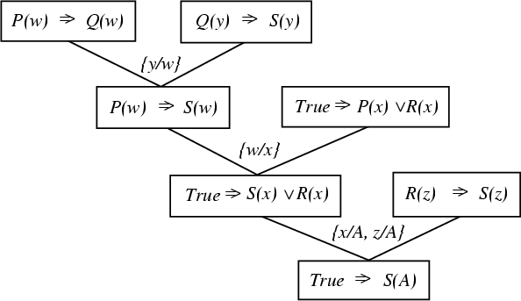
A resolution proof tree

Slide 71
Resolution refutation
Given a consistent set of axioms KB and goal sentence Q, show that KB |= Q
Proof by contradiction: Add ¬Q to KB and try to prove false.
i.e., (KB |- Q) ↔ (KB ∨ ¬Q |- False)
Resolution is refutation complete: it can establish that a given sentence Q is entailed by KB, but can’t (in general) be used to generate all logical consequences of a set of sentences
Also, it cannot be used to prove that Q is not entailed by KB.
Resolution won’t always give an answer since entailment is only semidecidable
And you can’t just run two proofs in parallel, one trying to prove Q and the other trying to prove ¬Q, since KB might not entail either one

Slide 72
Refutation resolution proof tree
¬allergies(w) v sneeze(w)
¬cat(y) v ¬allergic-to-cats(z) ∨ allergies(z)
w/z
¬cat(y) v sneeze(z) ∨ ¬allergic-to-cats(z)
cat(Felix)
y/Felix
sneeze(z) v ¬allergic-to-cats(z)
allergic-to-cats(Lise)
z/Lise
sneeze(Lise)
¬sneeze(Lise)
false
negated query

Slide 73
We need answers to the following questions
How to convert FOL sentences to conjunctive normal form (a.k.a. CNF, clause form): normalization and skolemization
How to unify two argument lists, i.e., how to find their most general unifier (mgu) θ: unification
How to determine which two clauses in KB should be resolved next (among all resolvable pairs of clauses) : resolution (search) strategy

Slide 74
Converting to CNF

Slide 75
Converting sentences to CNF
1. Eliminate all ↔ connectives
(P ↔ Q) ⇒ ((P → Q) ^ (Q → P))
2. Eliminate all → connectives
(P → Q) ⇒ (¬P ∨ Q)
3. Reduce the scope of each negation symbol to a single predicate
¬¬P ⇒ P
¬(P ∨ Q) ⇒ ¬P ∧ ¬Q
¬(P ∧ Q) ⇒ ¬P ∨ ¬Q
¬(∀x)P ⇒ (∃x)¬P
¬(∃x)P ⇒ (∀x)¬P
4. Standardize variables: rename all variables so that each quantifier has its own unique variable name

Slide 76
Converting sentences to clausal form Skolem constants and functions
5. Eliminate existential quantification by introducing Skolem constants/functions
(∃x)P(x) ⇒ P(c)
c is a Skolem constant (a brand-new constant symbol that is not used in any other sentence)
(∀x)(∃y)P(x,y) ⇒ (∀x)P(x, f(x))
since ∃ is within the scope of a universally quantified variable, use a Skolem function f to construct a new value that depends on the universally quantified variable
f must be a brand-new function name not occurring in any other sentence in the KB.
E.g., (∀x)(∃y)loves(x,y) ⇒ (∀x)loves(x,f(x))
In this case, f(x) specifies the person that x loves

Slide 77
Converting sentences to clausal form
6. Remove universal quantifiers by (1) moving them all to the left end; (2) making the scope of each the entire sentence; and (3) dropping the “prefix” part
Ex: (∀x)P(x) ⇒ P(x)
7. Put into conjunctive normal form (conjunction of disjunctions) using distributive and associative laws
(P ∧ Q) ∨ R ⇒ (P ∨ R) ∧ (Q ∨ R)
(P ∨ Q) ∨ R ⇒ (P ∨ Q ∨ R)
8. Split conjuncts into separate clauses
9. Standardize variables so each clause contains only variable names that do not occur in any other clause

Slide 78
An example
(∀x)(P(x) → ((∀y)(P(y) → P(f(x,y))) ∧ ¬(∀y)(Q(x,y) → P(y))))
2. Eliminate →
(∀x)(¬P(x) ∨ ((∀y)(¬P(y) ∨ P(f(x,y))) ∧ ¬(∀y)(¬Q(x,y) ∨ P(y))))
3. Reduce scope of negation
(∀x)(¬P(x) ∨ ((∀y)(¬P(y) ∨ P(f(x,y))) ∧(∃y)(Q(x,y) ∧ ¬P(y))))
4. Standardize variables
(∀x)(¬P(x) ∨ ((∀y)(¬P(y) ∨ P(f(x,y))) ∧(∃z)(Q(x,z) ∧ ¬P(z))))
5. Eliminate existential quantification
(∀x)(¬P(x) ∨((∀y)(¬P(y) ∨ P(f(x,y))) ∧(Q(x,g(x)) ∧ ¬P(g(x)))))
6. Drop universal quantification symbols
(¬P(x) ∨ ((¬P(y) ∨ P(f(x,y))) ∧(Q(x,g(x)) ∧ ¬P(g(x)))))

Slide 79
Example
7. Convert to conjunction of disjunctions
(¬P(x) ∨ ¬P(y) ∨ P(f(x,y))) ∧ (¬P(x) ∨ Q(x,g(x))) ∧
(¬P(x) ∨ ¬P(g(x)))
8. Create separate clauses
¬P(x) ∨ ¬P(y) ∨ P(f(x,y))
¬P(x) ∨ Q(x,g(x))
¬P(x) ∨ ¬P(g(x))
9. Standardize variables
¬P(x) ∨ ¬P(y) ∨ P(f(x,y))
¬P(z) ∨ Q(z,g(z))
¬P(w) ∨ ¬P(g(w))

Slide 80
Resolution example

Slide 81
Practice example Did Curiosity kill the cat
Jack owns a dog. Every dog owner is an animal lover. No animal lover kills an animal. Either Jack or Curiosity killed the cat, who is named Tuna. Did Curiosity kill the cat?
These can be represented as follows:
A. (∃x) Dog(x) ∧ Owns(Jack,x)
B. (∀x) ((∃y) Dog(y) ∧ Owns(x, y)) → AnimalLover(x)
C. (∀x) AnimalLover(x) → ((∀y) Animal(y) → ¬Kills(x,y))
D. Kills(Jack,Tuna) ∨ Kills(Curiosity,Tuna)
E. Cat(Tuna)
F. (∀x) Cat(x) → Animal(x)
G. Kills(Curiosity, Tuna)
GOAL

Slide 83
Converting sentences to CNF
1. Eliminate all ↔ connectives
(P ↔ Q) ⇒ ((P → Q) ^ (Q → P))
2. Eliminate all → connectives
(P → Q) ⇒ (¬P ∨ Q)
3. Reduce the scope of each negation symbol to a single predicate
¬¬P ⇒ P
¬(P ∨ Q) ⇒ ¬P ∧ ¬Q
¬(P ∧ Q) ⇒ ¬P ∨ ¬Q
¬(∀x)P ⇒ (∃x)¬P
¬(∃x)P ⇒ (∀x)¬P
4. Standardize variables: rename all variables so that each quantifier has its own unique variable name

Slide 84
Converting sentences to clausal form Skolem constants and functions
5. Eliminate existential quantification by introducing Skolem constants/functions
(∃x)P(x) ⇒ P(c)
c is a Skolem constant (a brand-new constant symbol that is not used in any other sentence)
(∀x)(∃y)P(x,y) ⇒ (∀x)P(x, f(x))
since ∃ is within the scope of a universally quantified variable, use a Skolem function f to construct a new value that depends on the universally quantified variable
f must be a brand-new function name not occurring in any other sentence in the KB.
E.g., (∀x)(∃y)loves(x,y) ⇒ (∀x)loves(x,f(x))
In this case, f(x) specifies the person that x loves

Slide 85
Converting sentences to clausal form
6. Remove universal quantifiers by (1) moving them all to the left end; (2) making the scope of each the entire sentence; and (3) dropping the “prefix” part
Ex: (∀x)P(x) ⇒ P(x)
7. Put into conjunctive normal form (conjunction of disjunctions) using distributive and associative laws
(P ∧ Q) ∨ R ⇒ (P ∨ R) ∧ (Q ∨ R)
(P ∨ Q) ∨ R ⇒ (P ∨ Q ∨ R)
8. Split conjuncts into separate clauses
9. Standardize variables so each clause contains only variable names that do not occur in any other clause

Slide 87
Convert to clause form
A1. (Dog(D))
A2. (Owns(Jack,D))
B. (¬Dog(y), ¬Owns(x, y), AnimalLover(x))
C. (¬AnimalLover(a), ¬Animal(b), ¬Kills(a,b))
D. (Kills(Jack,Tuna), Kills(Curiosity,Tuna))
E. Cat(Tuna)
F. (¬Cat(z), Animal(z))
Add the negation of query:
¬G: (¬Kills(Curiosity, Tuna))
D is a skolem constant

Slide 88
The resolution refutation proof
R1: ¬G, D, {} (Kills(Jack, Tuna))
R2: R1, C, {a/Jack, b/Tuna} (~AnimalLover(Jack), ~Animal(Tuna))
R3: R2, B, {x/Jack} (~Dog(y), ~Owns(Jack, y), ~Animal(Tuna))
R4: R3, A1, {y/D} (~Owns(Jack, D), ~Animal(Tuna))
R5: R4, A2, {} (~Animal(Tuna))
R6: R5, F, {z/Tuna} (~Cat(Tuna))
R7: R6, E, {} FALSE

Slide 90
The proof tree
¬G
D
{}
R1: K(J,T)
C
{a/J,b/T}
R2: ¬AL(J) ∨ ¬A(T)
B
{x/J}
R3: ¬D(y) ∨ ¬O(J,y) ∨ ¬A(T)
A1
{y/D}
R4: ¬O(J,D), ¬A(T)
A2
{}
R5: ¬A(T)
F
{z/T}
R6: ¬C(T)
A
{}
R7: FALSE

Slide 91
Resolution search strategies

Slide 92
Resolution TP as search
Resolution can be thought of as the bottom-up construction of a search tree, where the leaves are the clauses produced by KB and the negation of the goal
When a pair of clauses generates a new resolvent clause, add a new node to the tree with arcs directed from the resolvent to the two parent clauses
Resolution succeeds when a node containing the False clause is produced, becoming the root node of the tree
A strategy is complete if its use guarantees that the empty clause (i.e., false) can be derived whenever it is entailed

Slide 93
Strategies
There are a number of general (domain-independent) strategies that are useful in controlling a resolution theorem prover
We’ll briefly look at the following:
Breadth-first
Length heuristics
Set of support
Input resolution
Subsumption
Ordered resolution

Slide 94
Example
¬Battery-OK ∨ ¬Bulbs-OK ∨ Headlights-Work
¬Battery-OK ∨ ¬Starter-OK ∨ Empty-Gas-Tank ∨ Engine-Starts
¬Engine-Starts ∨ Flat-Tire ∨ Car-OK
Headlights-Work
Battery-OK
Starter-OK
¬Empty-Gas-Tank
¬Car-OK
¬Flat-Tire
negated goal

Slide 95
Breadth-first search
Level 0 clauses are the original axioms and the negation of the goal
Level k clauses are the resolvents computed from two clauses, one of which must be from level k-1 and the other from any earlier level
Compute all possible level 1 clauses, then all possible level 2 clauses, etc.
Complete, but very inefficient

Slide 96
BFS example
¬Battery-OK ∨ ¬Bulbs-OK ∨ Headlights-Work
¬Battery-OK ∨ ¬Starter-OK ∨ Empty-Gas-Tank ∨ Engine-Starts
¬Engine-Starts ∨ Flat-Tire ∨ Car-OK
Headlights-Work
Battery-OK
Starter-OK
¬Empty-Gas-Tank
¬Car-OK
¬Flat-Tire
¬Battery-OK ∨ ¬Bulbs-OK
¬Bulbs-OK ∨ Headlights-Work
¬Battery-OK ∨ ¬Starter-OK ∨ Empty-Gas-Tank ∨ Flat-Tire ∨ Car-OK
¬Starter-OK ∨ Empty-Gas-Tank ∨ Engine-Starts
¬Battery-OK ∨ Empty-Gas-Tank ∨ Engine-Starts
¬Battery-OK ¬ Starter-OK ∨ Engine-Starts
… [and we’re still only at Level 1!]
1,4
1,5
2,3
2,5
2,6
2,7

Slide 97
Length heuristics
Shortest-clause heuristic: Generate a clause with the fewest literals first
Unit resolution: Prefer resolution steps in which at least one parent clause is a “unit clause,” i.e., a clause containing a single literal
Not complete in general, but complete for Horn clause KBs

Slide 98
Unit resolution example
¬Battery-OK ∨ ¬Bulbs-OK ∨ Headlights-Work
¬Battery-OK ∨ ¬Starter-OK ∨ Empty-Gas-Tank ∨ Engine-Starts
¬Engine-Starts ∨ Flat-Tire ∨ Car-OK
Headlights-Work
Battery-OK
Starter-OK
¬Empty-Gas-Tank
¬Car-OK
¬Flat-Tire
¬Bulbs-OK ∨ Headlights-Work
¬Starter-OK ∨ Empty-Gas-Tank ∨ Engine-Starts
¬Battery-OK ∨ Empty-Gas-Tank ∨ Engine-Starts
¬Battery-OK ¬ Starter-OK ∨ Engine-Starts
¬Engine-Starts ∨ Flat-Tire
¬Engine-Starts ¬ Car-OK
… [this doesn’t seem to be headed anywhere either!]
1,5
2,5
2,6
2,7
3,8
3,9

Slide 99
Set of support
At least one parent clause must be the negation of the goal or a “descendant” of such a goal clause (i.e., derived from a goal clause)
(When there’s a choice, take the most recent descendant)
Complete (assuming all possible set-of-support clauses are derived)
Gives a goal-directed character to the search

Slide 100
Set of support example
¬Battery-OK ∨ ¬Bulbs-OK ∨ Headlights-Work
¬Battery-OK ∨ ¬Starter-OK ∨ Empty-Gas-Tank ∨ Engine-Starts
¬Engine-Starts ∨ Flat-Tire ∨ Car-OK
Headlights-Work
Battery-OK
Starter-OK
¬Empty-Gas-Tank
¬Car-OK
¬Flat-Tire
¬Engine-Starts ∨ Car-OK
¬Battery-OK ∨ ¬Starter-OK ∨ Empty-Gas-Tank ∨ Car-OK
¬Engine-Starts
¬Starter-OK ∨ Empty-Gas-Tank ∨ Car-OK
¬Battery-OK ∨ Empty-Gas-Tank ∨ Car-OK
¬Battery-OK ∨ ¬Starter-OK ∨ Car-OK
… [a bit more focused, but we still seem to be wandering]
9,3
10,2
10,8
11,5
11,6
11,7

Slide 101
Unit resolution + set of support example
¬Battery-OK ∨ ¬Bulbs-OK ∨ Headlights-Work
¬Battery-OK ∨ ¬Starter-OK ∨ Empty-Gas-Tank ∨ Engine-Starts
¬Engine-Starts ∨ Flat-Tire ∨ Car-OK
Headlights-Work
Battery-OK
Starter-OK
¬Empty-Gas-Tank
¬Car-OK
¬Flat-Tire
¬Engine-Starts ∨ Car-OK
¬Engine-Starts
¬Battery-OK ∨ ¬Starter-OK ∨ Empty-Gas-Tank
¬Starter-OK ∨ Empty-Gas-Tank
Empty-Gas-Tank
FALSE
[Hooray! Now that’s more like it!]
9,3
10,8
12,2
12,5
13,6
14,7

Slide 102
Simplification heuristics
Subsumption: Eliminate all sentences that are subsumed by (more specific than) an existing sentence to keep the KB small
If P(x) is already in the KB, adding P(A) makes no sense – P(x) is a superset of P(A)
Likewise adding P(A) ∨ Q(B) would add nothing to the KB
Tautology: Remove any clause containing two complementary literals (tautology)
Pure symbol: If a symbol always appears with the same “sign,” remove all the clauses that contain it

Slide 103
Example (Pure Symbol)
¬Battery-OK ∨ ¬Bulbs-OK ∨ Headlights-Work
¬Battery-OK ∨ ¬Starter-OK ∨ Empty-Gas-Tank ∨ Engine-Starts
¬Engine-Starts ∨ Flat-Tire ∨ Car-OK
Headlights-Work
Battery-OK
Starter-OK
¬Empty-Gas-Tank
¬Car-OK
¬Flat-Tire

Slide 104
Input resolution
At least one parent must be one of the input sentences (i.e., either a sentence in the original KB or the negation of the goal)
Not complete in general, but complete for Horn clause KBs
Linear resolution
Extension of input resolution
One of the parent sentences must be an input sentence or an ancestor of the other sentence
Complete

Slide 105
Ordered resolution
Search for resolvable sentences in order (left to right)
This is how Prolog operates
Resolve the first element in the sentence first
This forces the user to define what is important in generating the “code”
The way the sentences are written controls the resolution

Slide 106
Prolog
A logic programming language based on Horn clauses
Resolution refutation
Control strategy: goal-directed and depth-first
always start from the goal clause
always use the new resolvent as one of the parent clauses for resolution
backtracking when the current thread fails
complete for Horn clause KB
Support answer extraction (can request single or all answers)
Orders the clauses and literals within a clause to resolve non-determinism
Q(a) may match both Q(x) <= P(x) and Q(y) <= R(y)
A (sub)goal clause may contain more than one literals, i.e., <= P1(a), P2(a)
Use “closed world” assumption (negation as failure)
If it fails to derive P(a), then assume ~P(a)

Slide 107
Knowledge Representation

Slide 108
Knowledge Based Systems
Knowledge Base
FoL or Propositional logic based knowledge representation
Inference Engine
Using Resolution, FC, BC algorithms for inferences and decision making

Slide 109
Automated Reasoning systems
Theorem provers – Prove sentences in the first-order logic. Use inference rules, resolution rule and resolution refutation.
Deductive retrieval systems – Systems based on rules (KBs in Horn form) – Prove theorems or infer new assertions
Production systems – Systems based on rules with actions in antecedents – Forward chaining mode of operation
Semantic networks – Graphical representation of the world, objects are nodes in the graphs, relations are various links
Frames: – object oriented representation, some procedural control of inference

Slide 110
Production systems
Based on rules, but different from KBs in the Horn form Knowledge base is divided into:
A Rule base (includes rules)
A Working memory (includes facts) Rules: a special type of if – then rule Basic operation:
Rules: A conjunction of conditions called antecedent and a sequence of actions called consequent
Basic operation
Check if the antecedent of a rule is satisfied
Decide which rule to execute (if more than one rule is satisfied)
Execute actions in the consequent of the rule

Slide 111
Working memory
Consists of a set of facts – statements about the world but also can represent various data structures
The exact syntax and representation of facts may differ across different systems
Examples:
predicates
such as Red(car12)
but only ground statements
or
(type attr1:value1 attr2:value2 …) objects
such as: (person age 27 home Toronto)
The type, attributes and values are all atoms

Slide 112
Rules
Using FoL / PL rules
Consequent: a sequence of actions
An action can be:
ADD the fact to the working memory (WM)
REMOVE the fact from the WM
MODIFY an attribute field
QUERY the user for input, etc

Slide 113
Object oriented representation
Object-centered representations Objects: a natural way to organize the knowledge about
physical objects:
a desk has a surface-material, # of drawers, width, length, height, color, procedure for unlocking, etc.
some variations: no drawers, multi-level surface
situations:
a class: room, participants, teacher, day, time, seating arrangement, lighting, procedures for registering, grading, etc.
leg of a trip: destination, origin, conveyance, procedures for buying ticket, getting through customs, reserving hotel room, locating a car rental etc.
Important: Objects enable grouping of procedures for determining the properties of objects, their parts, interaction with parts

Slide 114
Frame based system
Predecessor of object-oriented systems
Two types of frames:
individual frames – represent a single object like a person, part of a trip
generic frames – represent categories of objects, like students Example:
A generic frame: Europian city • Individual frames: Paris, London, Prague

Slide 115
Frames
An individual frame is a named list of buckets called slots.
What goes in the bucket is called a filler of the slot.
(frame-name
<slot-name1 filler1>
<slot-name2 filler2>…. )

Slide 116
Frames
Individual frames have a special slot called : INSTANCE-OF whose filler is the name of a generic frame:
Example: (toronto % lower case for individual frames
<:INSTANCE-OF CandadianCity>
<:Province Ontario>
<:Population 4.5M>…)
Generic frames may have IS-A slot that includes generic frame • (CanadianCity % upper case for generic frames
<:IS_A City>
<:Province Canadian Province>

Slide 117
Frames – Inference control
Slots in generic frames can have associated procedures that are executed and ‘control’ inference
Two types of procedures:
IF-NEEDED procedure; executes when no slot filler is given and the value is needed (Table …)
IF-ADDED procedure. If a slot filler is given its effect may propagate to other frames (say to assure constraints) (Lecture …)
the filler for :DayOfWeek will be calculated when :Date is filled

Slide 118
Frames – reasoning
Basic reasoning goes like this:
user instantiates a frame, i.e., declares that an object or situation exists
slot fillers are inherited where possible
inherited IF-ADDED procedures are run, causing more frames to be instantiated and slots to be filled.
If the user or any procedure requires the filler of a slot then:
if there is a filler, it is used
otherwise, an inherited IF-NEEDED procedure is run, potentially causing additional actions

Slide 119
Frames – reasoning
Global reasoning:
make frames be major situations or object-types you need to flesh out
express constraints between slots as IF-NEEDED and IFADDED procedures
fill in default values when known

Slide 120
Ontology for Knowledge representation
In ontology engineering, knowledge is represented using a graph. • Each node of the graph represents a “concept”, and the edge between two nodes represents the relation between the two concepts.
A concept defines a group of existences. The form (shape or outlook), properties, states, etc. of these existences are memorized (capsulized) in the corresponding node.
The relation between two concepts may include causal relation, inclusion relation, membership relation, etc.
Using an ontology graph (compared with the production system), we can represent knowledge in a well-organized way, and people can understand the corresponding knowledge easily.

Slide 121
Ontology Engineering
In ontology engineering, we do not care what is the “origin” of the universe, but care about the “true meanings” of concepts.
With the true meanings, we can define knowledge that can be shared and understood universally (used by anybody with different culture backgrounds in the world).
For this purpose, researchers are trying to represent knowledge graphically, and open it to the world. People can then improve the knowledge graph or ontology graph from different angles.
Hopefully, after many years, some of the knowledge can be universally useful. This kind of knowledge will be language (platform) independent.

Slide 122
Semantic Network
Semantic network is a special case of ontology graph. In a semantic network, the knowledge is represented by a directed graph.
In each node, a concept is defined by
Concept (object) name;
Attributes; and
Attribute values.
An edge defines the relation between two concepts.

Slide 123
Example

Slide 124
Concept
The concept “cheetah” has the following attributes and corresponding values:
A1=food; Value=meat;
A2=speed; Value=fast;
A3=character; Value=fearful;
Fuzzy values are often used here to make them more understandable.

Slide 125
Example

Slide 126
Reasoning in Semantic network

Slide 127
Reasoning
Reasoning is equivalent to graph matching
A question network is generated for each question.
We get an answer when the question network matches to a sub-graph of the semantic network.

Slide 128
What Is “Ontology Engineering”?
Ontology Engineering:
Ontology engineering is a set of tasks related to the development of ontologies for a particular domain.
Defining terms in the domain and relations among them
Defining concepts in the domain (classes)
Arranging the concepts in a hierarchy (subclass-superclass hierarchy)
Defining which attributes and properties (slots) classes can have and constraints on their values
Defining individuals and filling in property values
Ontology Engineering analogous to OO Database Design?

Slide 129
Ontology Engineering versus Object-Oriented Modeling
An OO class structure
reflects the structure of the data and code
is usually about behavior (methods)
Object-oriented classes are templates for constructing objects.
Attributes and associations have different meanings.
Closed World Assumption.
An ontology
reflects the structure of the world
is often about structure of concepts
Formal ontological classes are sets which can be defined in terms of other classes, attributes and associations
Property is a general term for attributes and associations.
Open World Assumption
means that lack of knowledge of a fact does not immediately imply knowledge of the negation of a fact.
Notes:
DL does not make the Unique Name Assumption (UNA) or the Closed World Assumption (CWA). Not having UNA means that two concepts with different names may be allowed by some inference to be shown to be equivalent. Not having CWA, or rather having the Open World Assumption (OWA) means that lack of knowledge of a fact does not immediately imply knowledge of the negation of a fact.

Slide 130
Logic: Open versus Closed
Open (monotonic) logic gives different answers to queries than a closed logic.
hasBase
Pizza
PizzaBase
Fact:Suppose that Americana is the only Pizza:
Closed world: violates constraint
Open world: Americana Pizza exists but its base is not known.

Slide 131
Logic: Open versus Closed
Open (monotonic) logic gives different answers to queries than a closed logic.
hasBase
Pizza
PizzaBase
Fact:ItalianPizza has bases CrispBase and HardBase:
Closed world: violates constraint
Open world: CrispBase and HardBase are same!.
Notes:
Adv loosely coupled we can add information which is apparently inconsistent but the system resolves the inconsistencies

Slide 132
Axioms for OWL Ontology
An OWL ontology is a set of axioms
Class Axioms: C ⊑ D, C ≡ D
Role Axioms: R ⊑ S, Func(R), Trans(S)
Individual Axioms: a:C, <a,b>:R
Animal
CanSwim
Ontology example
Fish⊑ Animal ⊓ CanSwim
Jellyfish⊑ Fish⊓ ¬hasVertebra
Pomfret⊑ Fish
Moonjelly:Jellyfish
⊓
¬hasVertebra
Fish
⊓
Pomfret
Jellyfish
Moonjelly
Notes:
An OWL ontology is a set of axioms which include classes axioms C is a subclass of D, or C is equivalent to D, role axioms R is a subrole of S, R is a functional role, S is a transitive role, and individual axioms, a is an individual of C, a participates in a R role with b.
Here is an ontology example, fish is a sublcass of Animal and CanSwim, and fish is a subclass of animal and canswim…. Moonjelly is an individual of jellyfish.

Slide 133
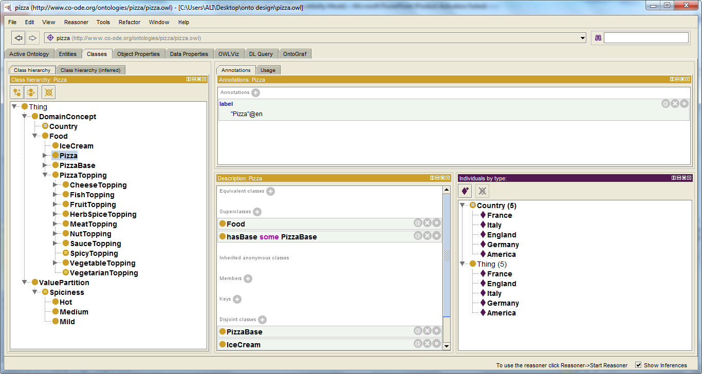
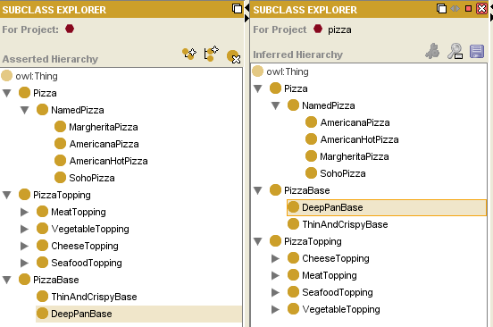
Food Domain: Pizza Ontology in Protege.

Slide 134
Ontology Engineering Process
An iterative process:
determine scope
consider reuse
enumerate
terms
consider reuse
define classes
enumerate
terms
define classes
define properties
define classes
define properties
define constraints
create instances
define classes
create instances
consider reuse
define properties
define constraints
create instances

Slide 135
Ontology Engineering Tools
Protégé, which:
is a graphical ontology-development tool
supports a rich knowledge model
is open-source and freely available (http://protege.stanford.edu)
Some other available tools:
Ontolingua and Chimaera
OntoEdit
OilEd
DOGMA
DogmaModeler
KAON
OntoClean
OnToContent
HOZO

Slide 136
Determine Domain and Scope
determine scope
consider reuse
enumerate
terms
define classes
define properties
define constraints
create instances
What is the domain that the ontology will cover?
For what we are going to use the ontology?
For what types of questions the information in the ontology should provide answers (competency questions)?
Answers to these questions may change during the lifecycle

Slide 137
Competency Questions For determining scope
Which Pizza characteristics should I consider when choosing a Pizza?
Is Veg or Non Veg?
Does Pizza go well with Ice Cream?
Which is the best choice among Veg pizza .
What kind of Pizza bases available?
Pizzas from which countries are available?
Which Pizza is the least spicy?

Slide 138
Consider Reuse
determine scope
consider reuse
enumerate
terms
define classes
define properties
define constraints
create instances
Why reuse other ontologies?
to save the effort
to interact with the tools that use other ontologies
to use ontologies that have been validated through use in applications
General ontologies
DMOZ (www.dmoz.org)
WordNet (www.cogsci.princeton.edu/~wn/)
Domain-specific ontologies
UMLS Semantic Net
GO (Gene Ontology) (www.geneontology.org)

Slide 139
Enumerate Important Terms
determine scope
consider reuse
enumerate
terms
define classes
define properties
define constraints
create instances
What are the terms we need to talk about?
What are the properties of these terms?
What do we want to say about the terms?

Slide 140
Enumerating Terms - The Pizza Ontology
Pizza, Cheese , Toppings , Mexican , Sauce , Pizza Base,
Crispy…

Slide 141
Define Classes and the Class Hierarchy
determine scope
consider reuse
enumerate
terms
define classes
define properties
define constraints
create instances
A class is a concept in the domain
a class of Pizza
a class of PizzaBase
a class of Country
A class is a collection of elements with similar properties
Instances of classes
VegSpicyPizza.

Slide 142
Class Inheritance
Classes usually constitute a taxonomic hierarchy (a subclass-superclass hierarchy)
A class hierarchy is usually an IS-A hierarchy:
an instance of a subclass is an instance of a superclass
If you think of a class as a set of elements, a subclass is a subset

Slide 143
Class Inheritance - Example
Pizza is a subclass of Food
VegetarianPizza is a subclass of Pizza
SpicyPizza is a subclass of VegetarianPizza.

Slide 144
Define Properties of Classes – Slots
determine scope
consider reuse
enumerate
terms
define classes
define properties
define constraints
create instances
Slots in a class definition describe attributes of instances of the class and relations to other instances
Each pizza will have hasBase, hasTopping hasCountryOfOrigin.

Slide 145
Properties (Slots)
Types of properties
Simple and complex properties
simple properties (attributes): contain primitive values (strings, numbers)
complex properties: contain (or point to) other objects (e.g., a Pizza instance)

Slide 146
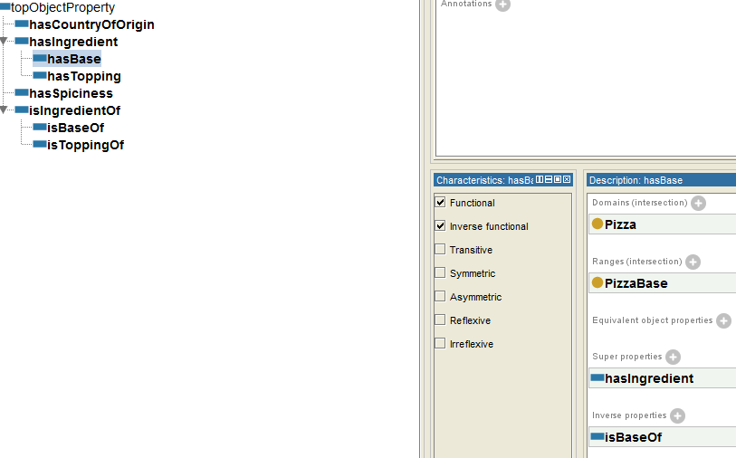
Properties for the Class Pizza
(in Protégé-2000)

Slide 147
property and Class Inheritance
A subclass inherits all the propertys from the superclass
If a Pizza has a name and flavor, a AmericanPizza also has a name and flavor
If a class has multiple superclasses, it inherits properties from all of them.

Slide 148
Create Instances \Individuals
determine scope
consider reuse
enumerate
terms
define classes
define properties
define constraints
create instances
Create an instance of a class
The class becomes a direct type of the instance
If concepts form a natural hierarchy, then we should represent them as classes
Individual instances are the most specific concepts represented in a knowledge base.
if we would like to maintain an inventory of pizzas in the restaurant then use individuals.
Assign property values for the instance
Notes:
\

Slide 149
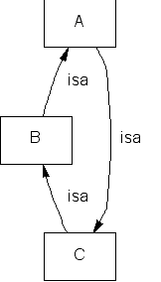
Avoiding Class Cycles
Danger of multiple inheritance: cycles in the class hierarchy
Classes A, B, and C have equivalent sets of instances
By many definitions, A, B, and C are thus equivalent

Slide 150
The Perfect Family Size
If a class has only one child, there may be a modeling problem
Put It up:
AmericanPizza ----→ AmericanCreamPizza
AmericanCreamPizza

Slide 151
Single and Plural Class Names
A “Pizza” is not a kind-of “Pizzas”
Class names should be either
all singular
all plural

